Slide 1
LAGOS

Slide 2
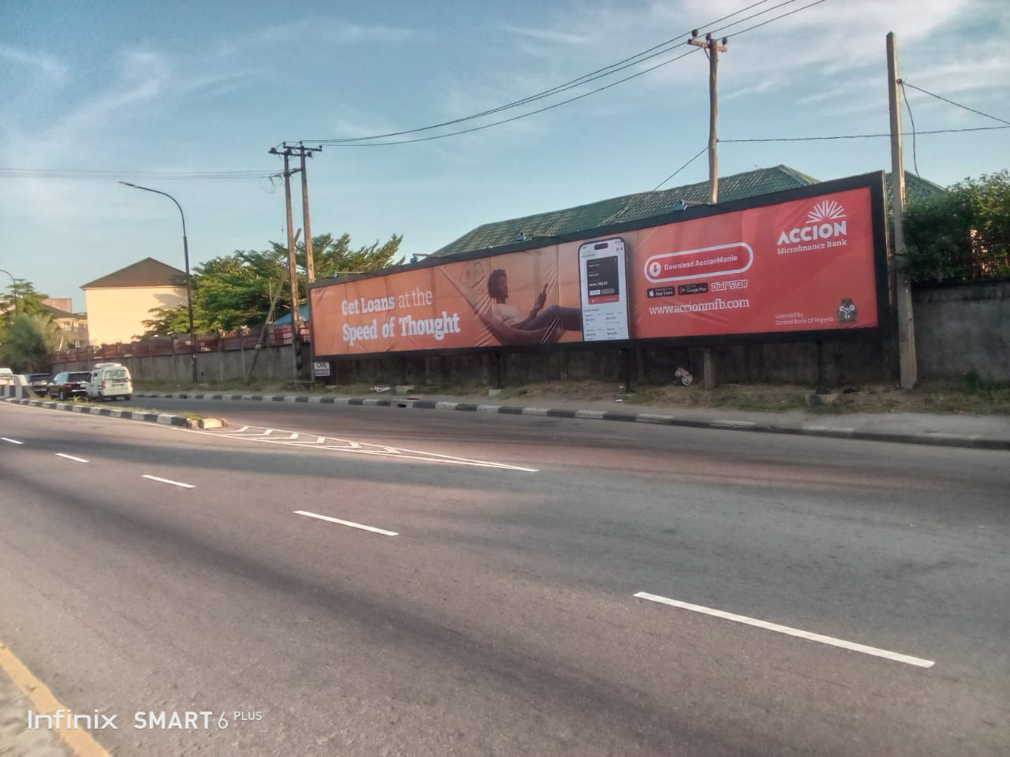
Location: Bonny Cantonment Fence before the entrance gate, Victoria Island, Lagos State.
Dimension: 24m x 3m (Wall Drape)

Slide 3
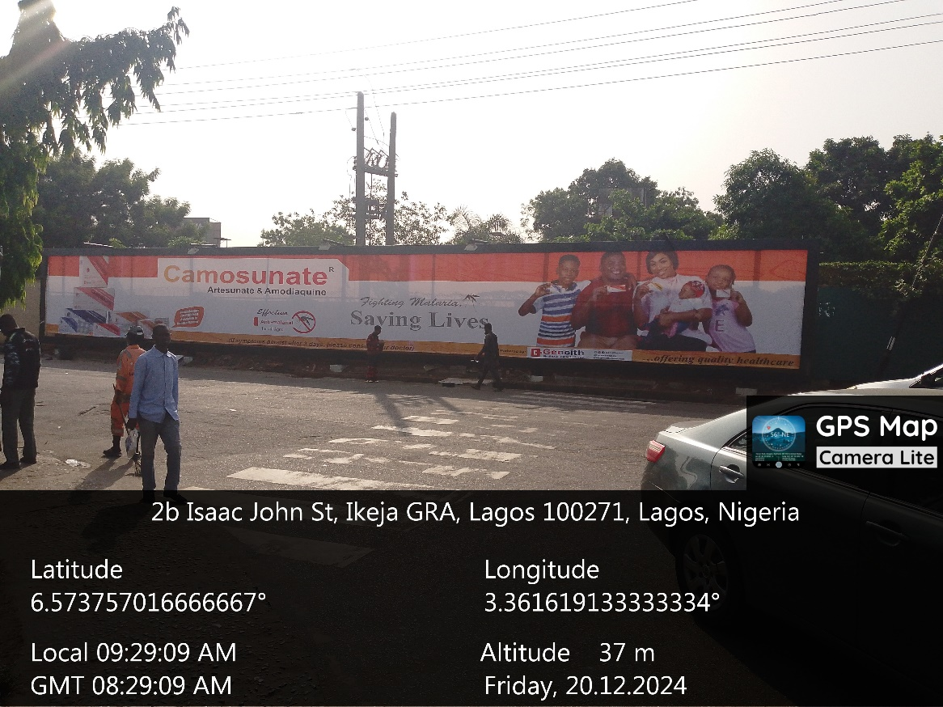
LOCATION: Cantonment Ikeja GRA, Adekunle Fajuyi by Isaac John, Lagos State.
STRUCTURE: Wall Drape
DIMENSION: 25m x 3m

Slide 4
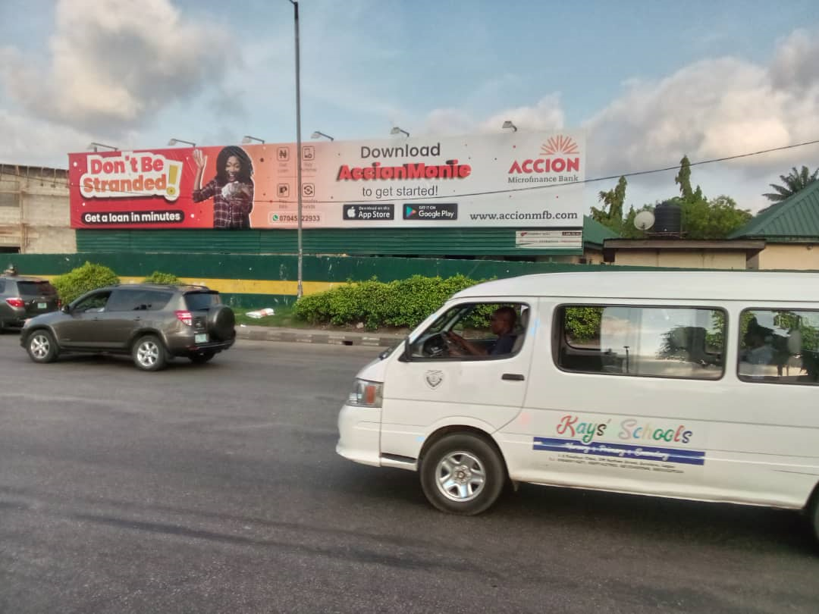
LOCATION: Abalti Barracks along Western Avenue, Ojuelegba, Surulere, Lagos State.
STRUCTURE: Stand Free Wall Drape
DIMENSION: 20m x 3m

Slide 5
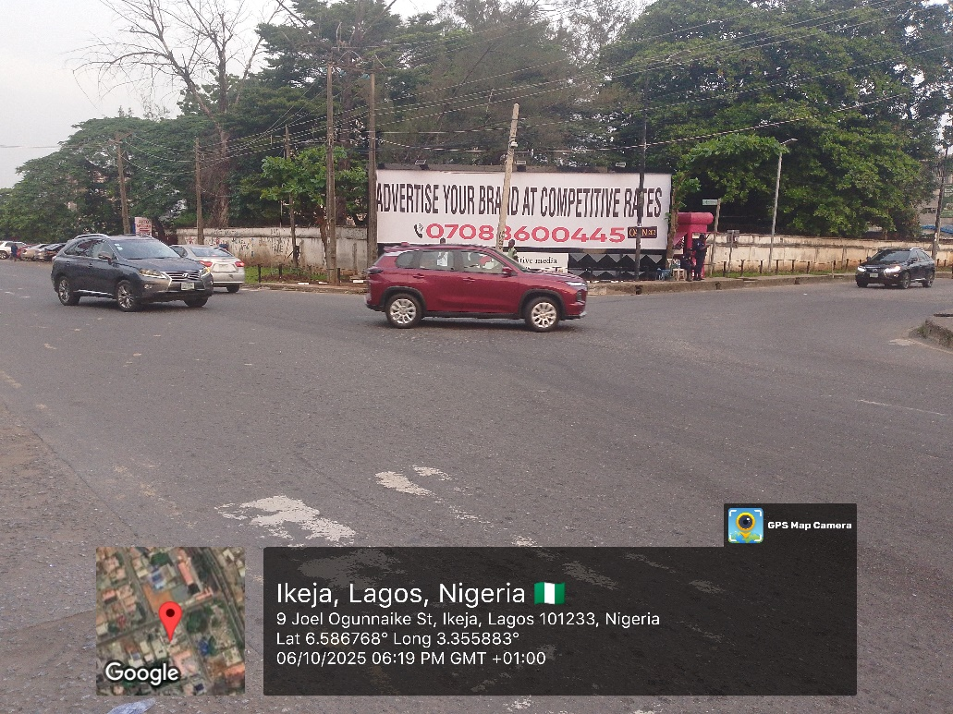
LOCATION: Along Isaac John Street at the intersection with Joel Ogunnaike Road off Mobolaji Bank Anthony Way, Ikeja, Lagos State.
STRUCTURE: Wall Drape
DIMENSION: 12m x 3m

Slide 6
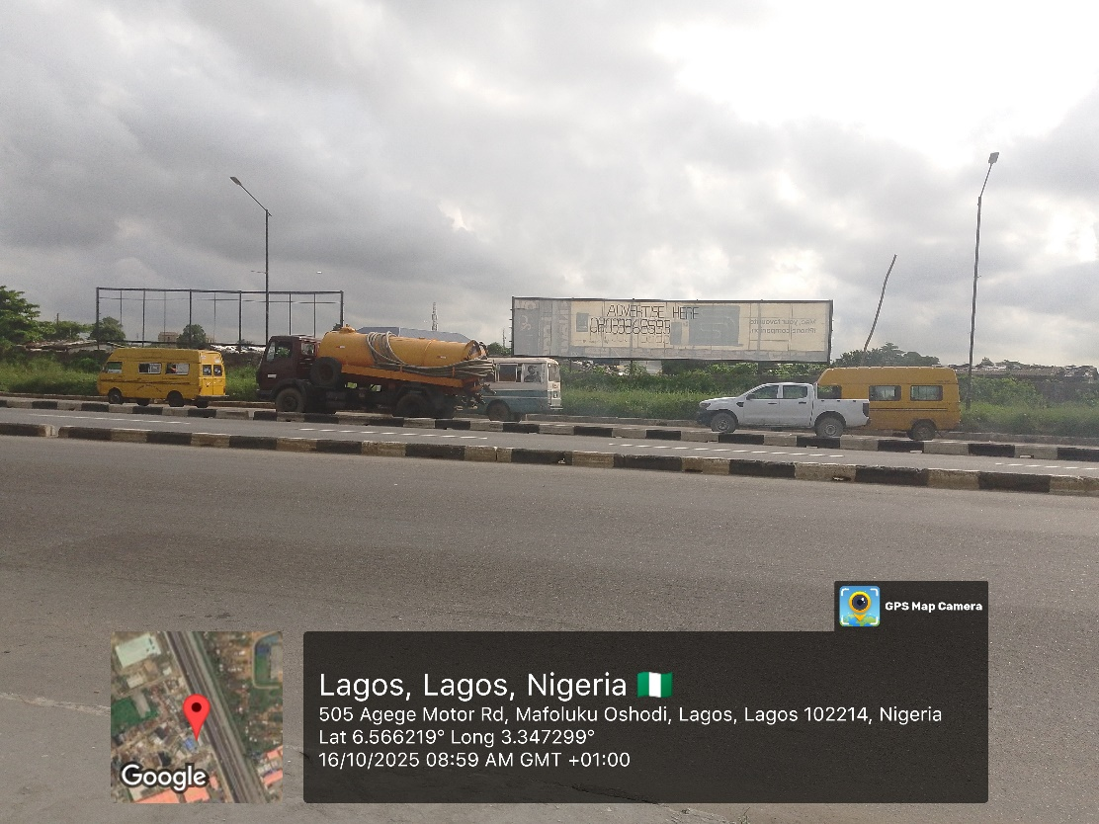
LOCATION: At the fence of T. A. Lagbaja Cantonment, FTF Bolade-Oshodi, Lagos State.
STRUCTURE: Stand Free Wall Drape
DIMENSION: 25m x 5m

Slide 7
ABUJA

Slide 8

LOCATION: Along Bala Mohammed Way, Guzape, FCT, Abuja.
STRUCTURE: Eyecatcher
DIMENSION: 14m x 3m

Slide 9
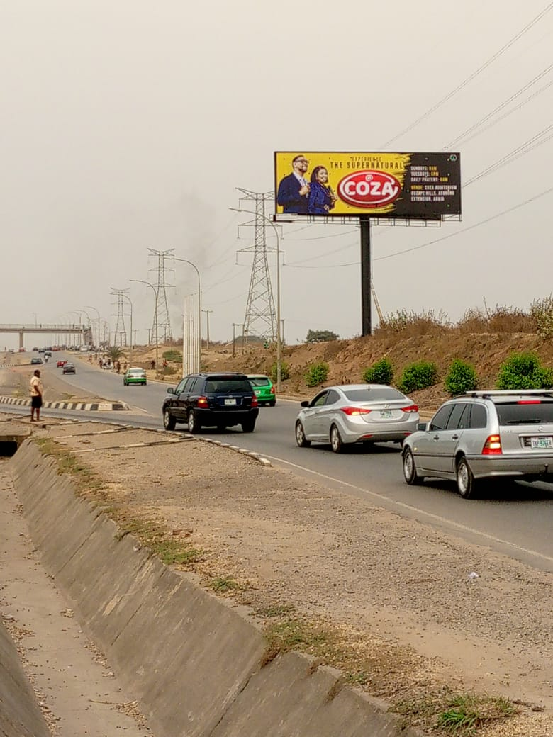
LOCATION: Along Umaru Musa Yar’Adua Expressway, opposite Police Sign Post Lugbe, FTF Airport Road, FCT, Abuja.
STRUCTURE: Unipole
DIMENSION: 18m x 6m

Slide 10
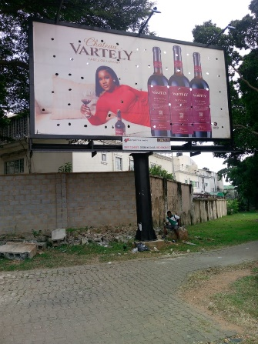
LOCATION: Along Ahmadu Bello Way by Kashim Ibrahim Way, FCT, Abuja.
STRUCTURE: Single Face Billboard
DIMENSION: 8.3m x 4.3m

Slide 11
KANO

Slide 12
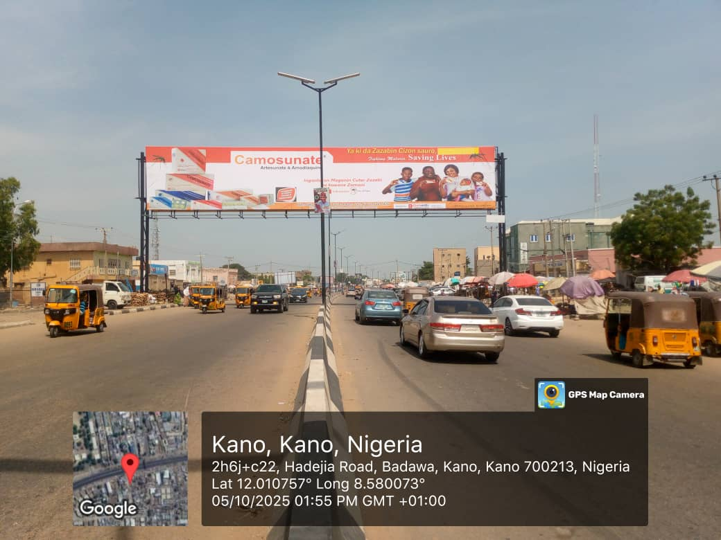
LOCATION: Hadejia Road, by Yankaba Market, Kano State.
STRUCTURE: Gantry
DIMENSION: 28m x 5m

Slide 13
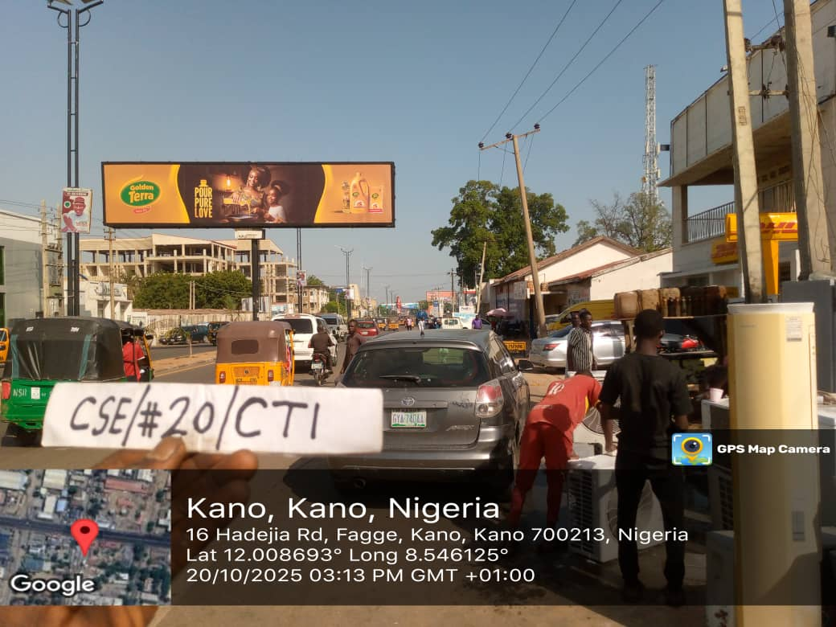
LOCATION: Murtala Mohammed Way, by DHL, Kano State.
STRUCTURE: Eyecatcher
DIMENSION: 16m x 3.5m

Slide 14
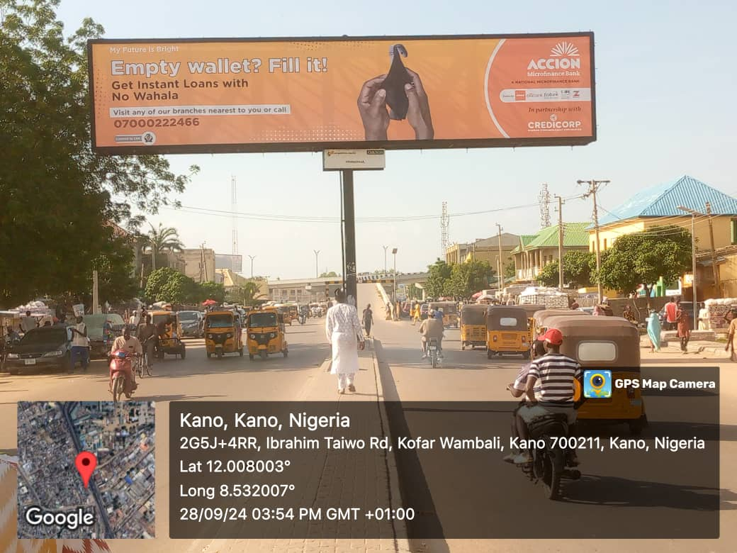
LOCATION: Ibrahim Taiwo Road, by Kano Guest Inn, Kano State.
STRUCTURE: Eyecatcher
DIMENSION: 16m x 3.5m

Slide 15
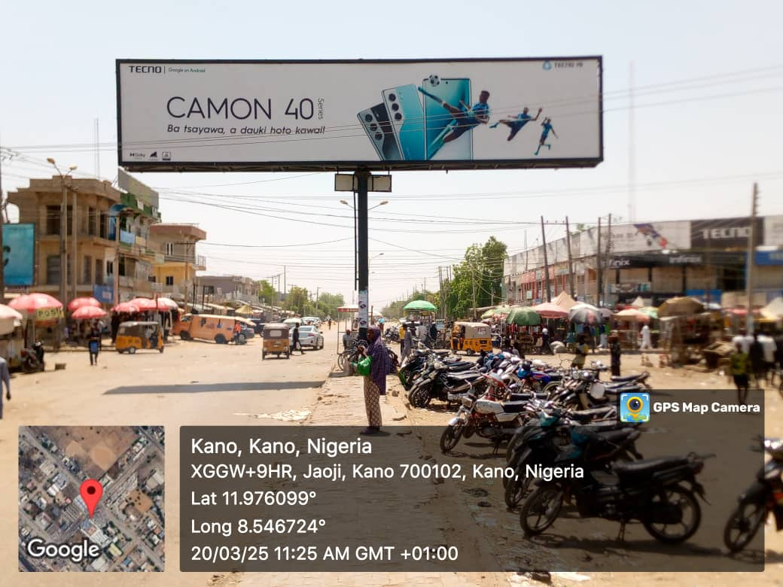
LOCATION: Farm Center Junction (Biggest Electronic Market in Kano), Kano State.
STRUCTURE: Eyecatcher
DIMENSION: 16m x 3.5m

Slide 16
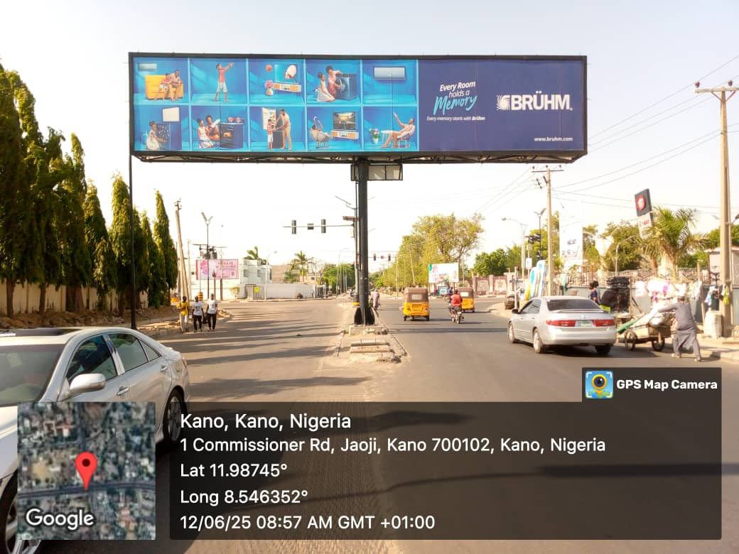
LOCATION: Audu Bako Junction, by State Road, Kano State.
STRUCTURE: Eyecatcher
DIMENSION: 16m x 3.5m

Slide 17
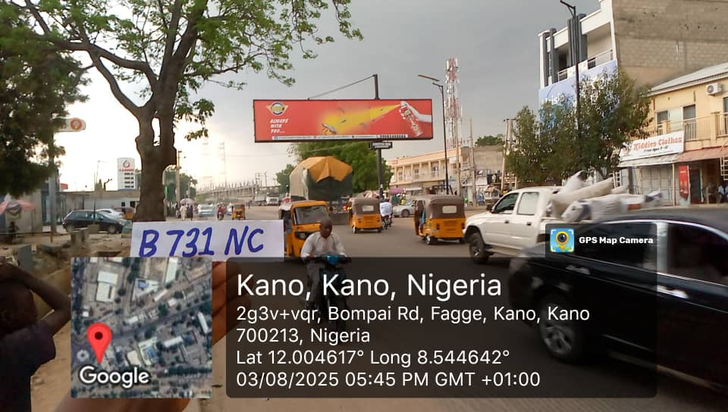
LOCATION: Bompai Road, Opposite Central Hotel, in front of Domino’s Pizza, Kano State.
STRUCTURE: Eyecatcher
DIMENSION: 16m x 3.5m

Slide 18
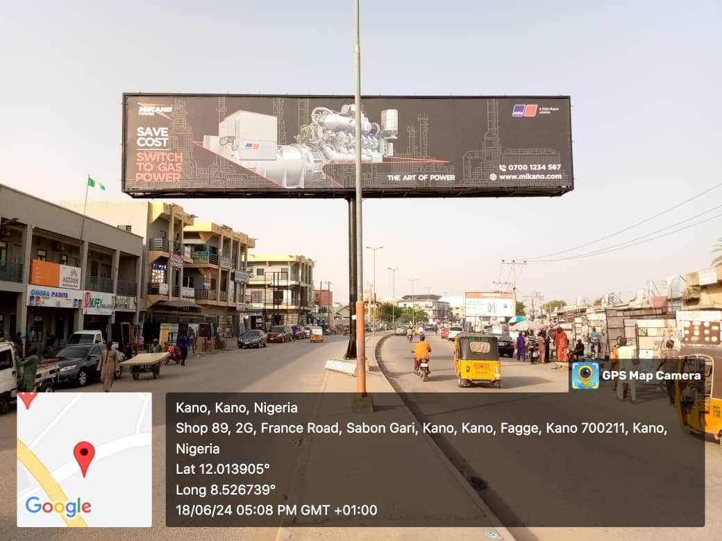
LOCATION: France Road before Katsina Road Junction, Sabon Gari, Kano State.
STRUCTURE: Eyecatcher
DIMENSION: 16m x 3.5m

Slide 19
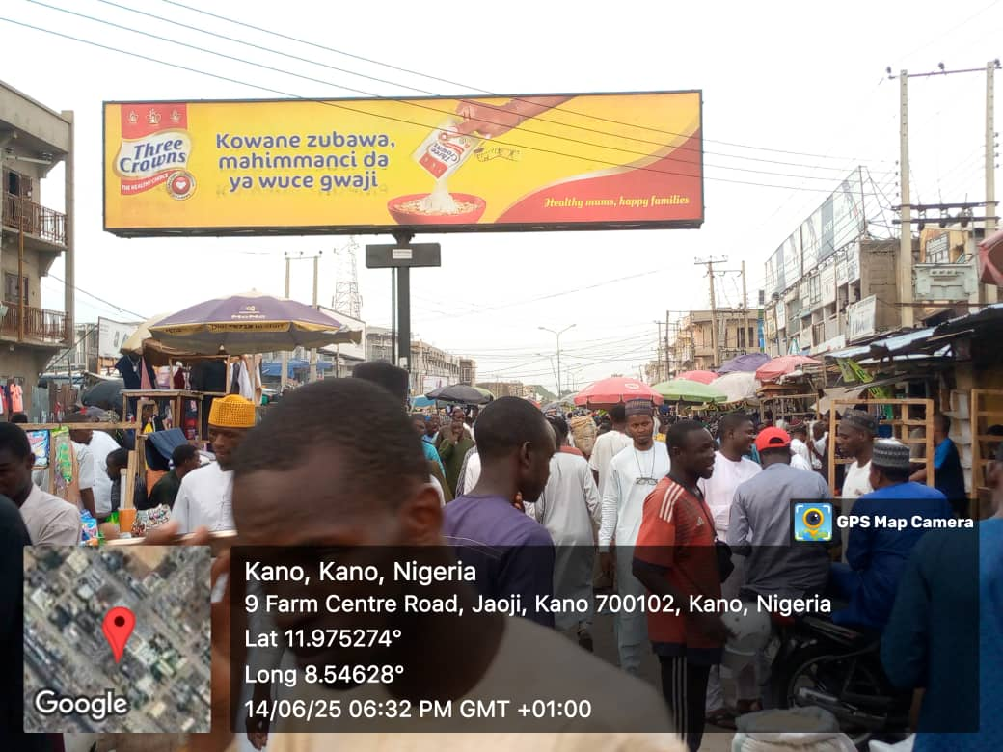
LOCATION: Farm Center Market, Kano State.
STRUCTURE: Eyecatcher
DIMENSION: 16m x 3.5m

Slide 20
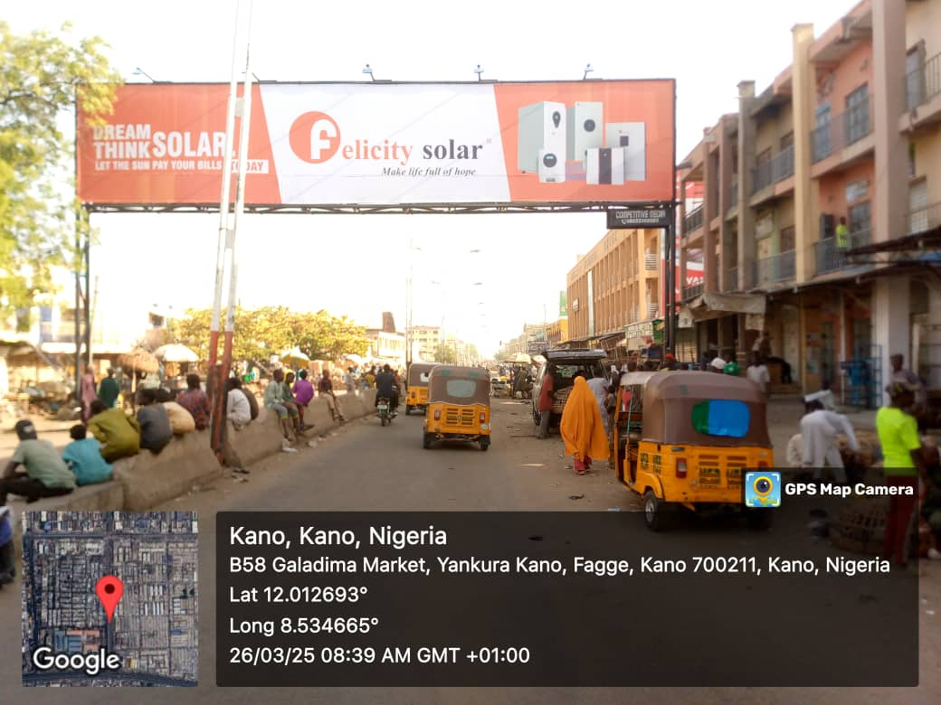
LOCATION: Yankura Market by the Bridge, Fagge, Kano State.
STRUCTURE: Gantry
DIMENSION: 20m x 4m

Slide 21
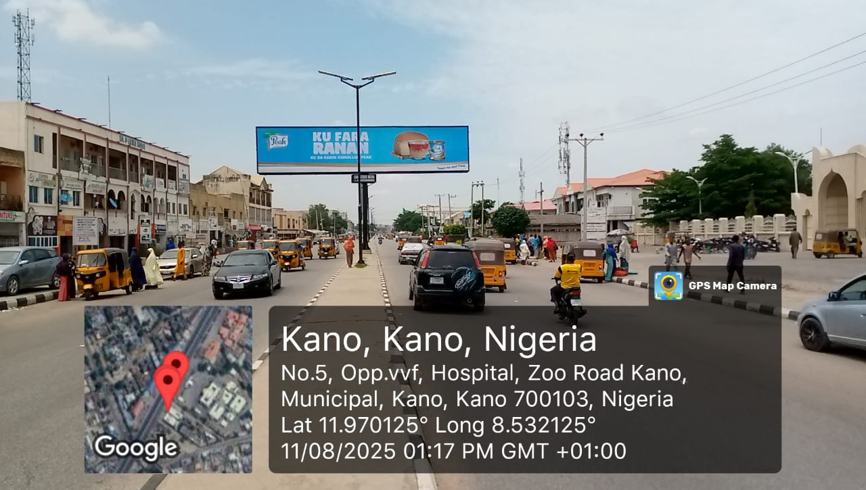
LOCATION: Zoo Road by Isyaka Rabiu Pediatric Hospital, Kano State.
STRUCTURE: Eyecatcher
DIMENSION: 16m x 3.5m

Slide 22
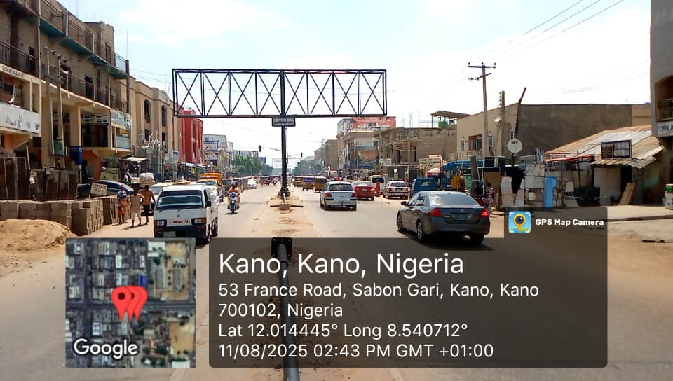
LOCATION: France Road by Igbo Road Junction, Sabon Gari, Kano State.
STRUCTURE: Eyecatcher
DIMENSION: 16m x 3.5m

Slide 23
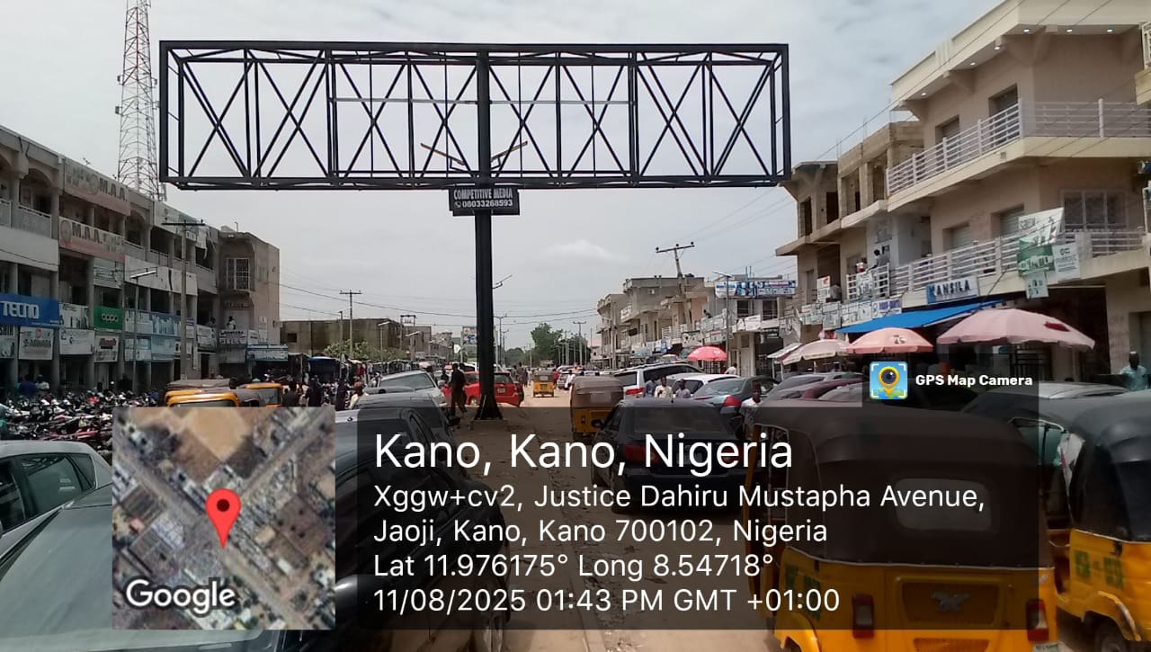
LOCATION: Farm Center Road, Kano State.
STRUCTURE: Eyecatcher
DIMENSION: 16m x 3.5m

Slide 24
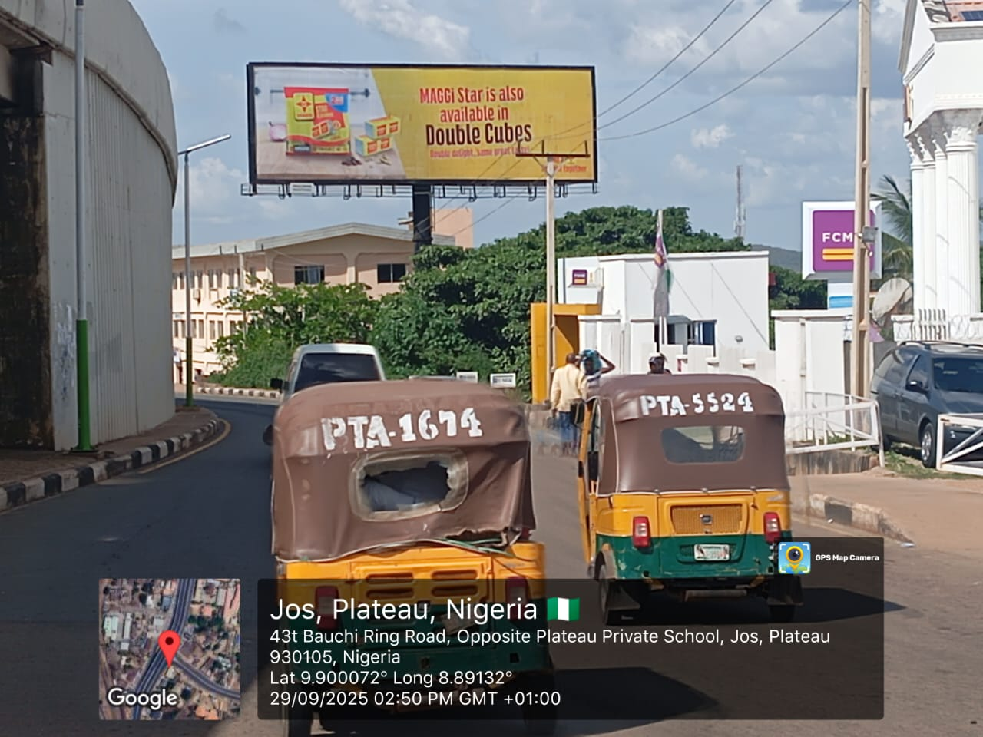
LOCATION: Jos British America Junction, by FCMB Opposite GTBank, Plateau State.
STRUCTURE: Unipole
DIMENSION: 18m x 6m

Slide 25
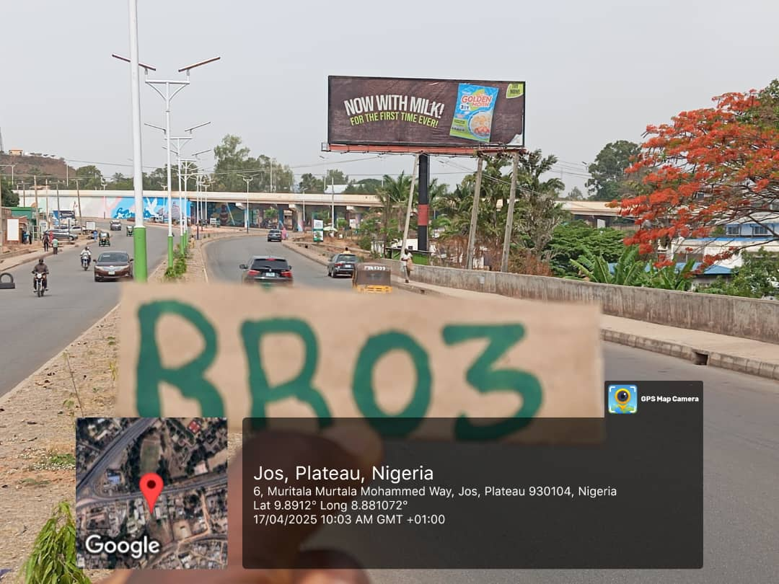
LOCATION: Jos Secretariat Junction, beside Federal Mortgage Bank, Plateau State.
STRUCTURE: Unipole
DIMENSION: 18m x 6m

Slide 26
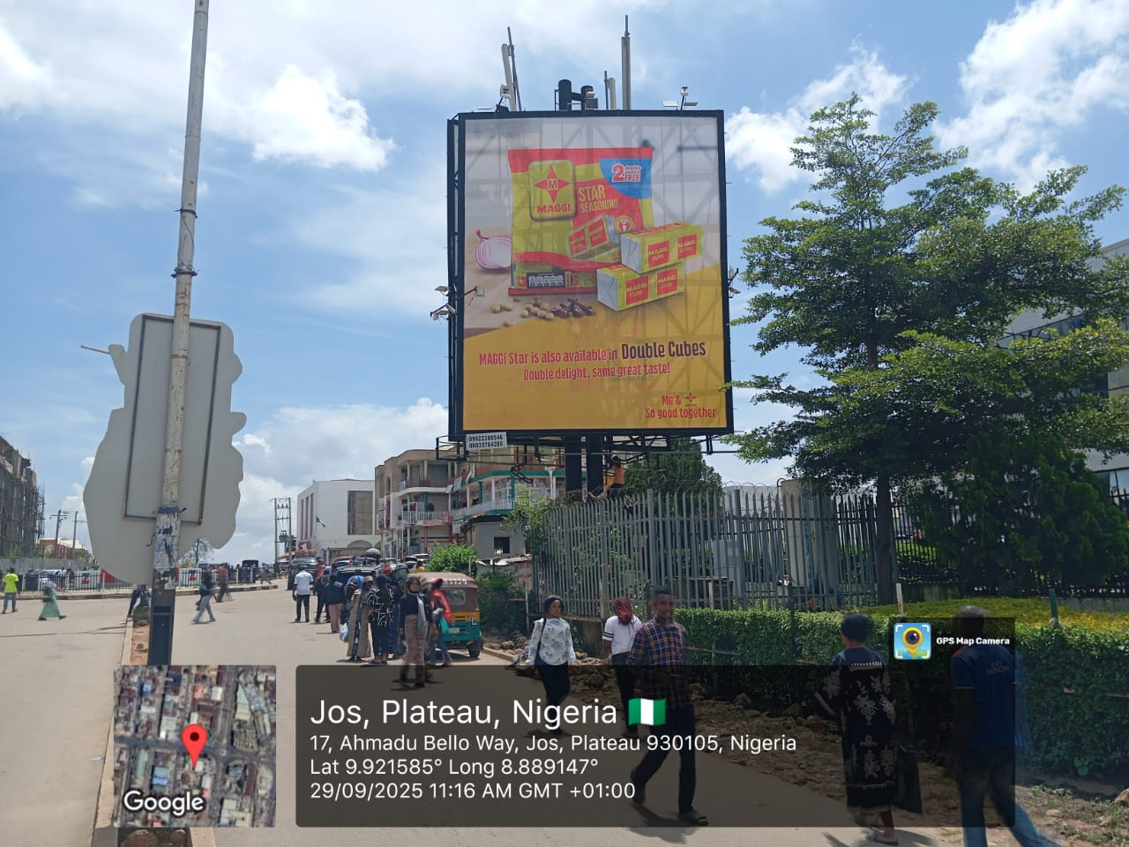
LOCATION: Jos Terminus, Tafawa Balewa Road, by Zenith Bank, Plateau State.
STRUCTURE: Portrait
DIMENSION: 10m x 8m

Slide 27
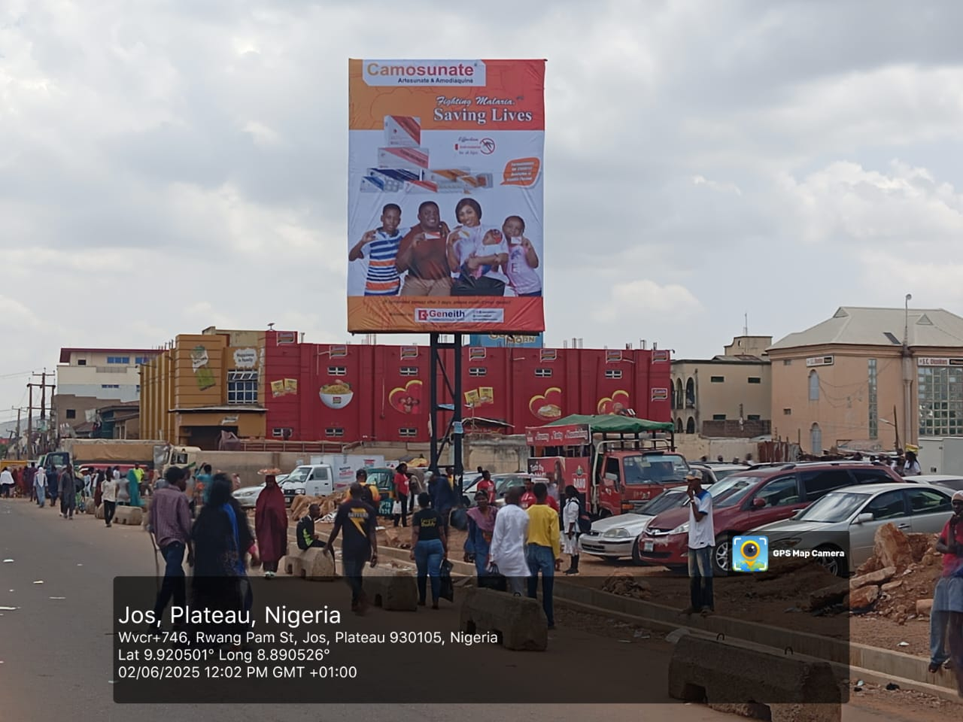
LOCATION: Jos Main Market, by Mama Tapgun Roundabout, Plateau State.
STRUCTURE: Portrait
DIMENSION: 7m x 5m

Slide 28
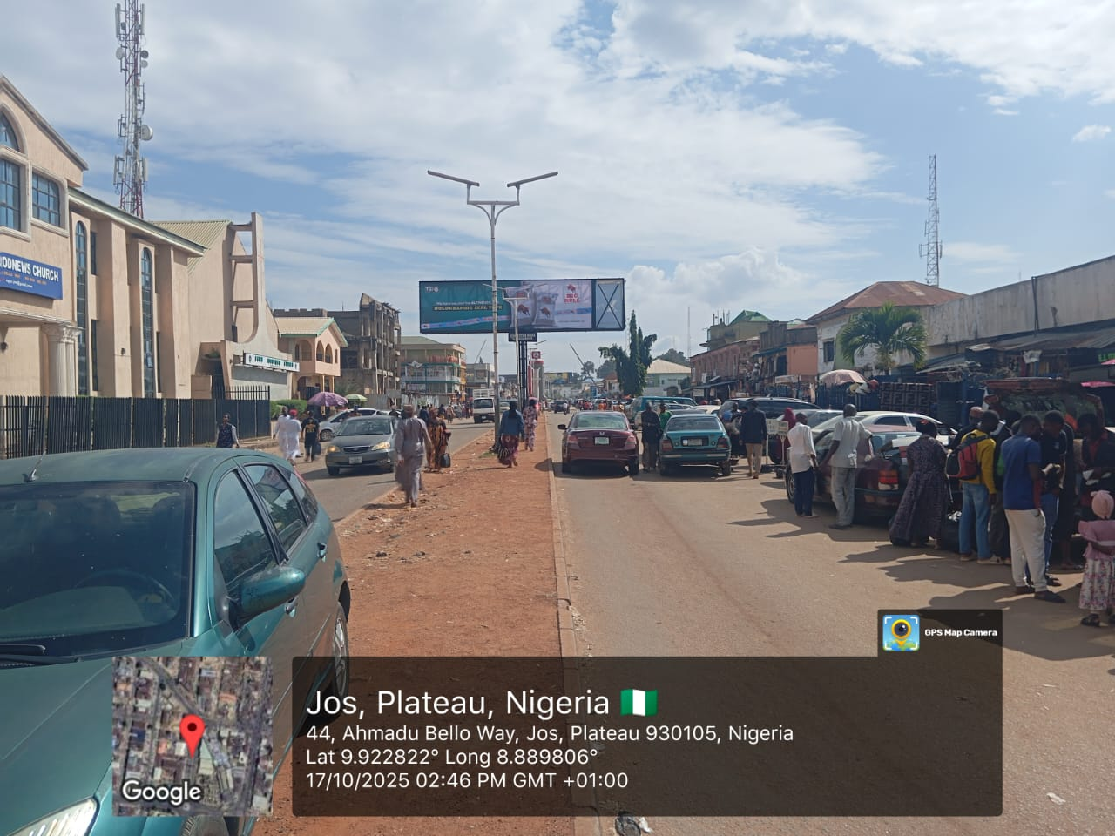
LOCATION: Jos Terminus, along Ahmadu Bello Way, Plateau State.
STRUCTURE: Eyecatcher
DIMENSION: 12m x 3.5m

Slide 29
ANAMBRA

Slide 30
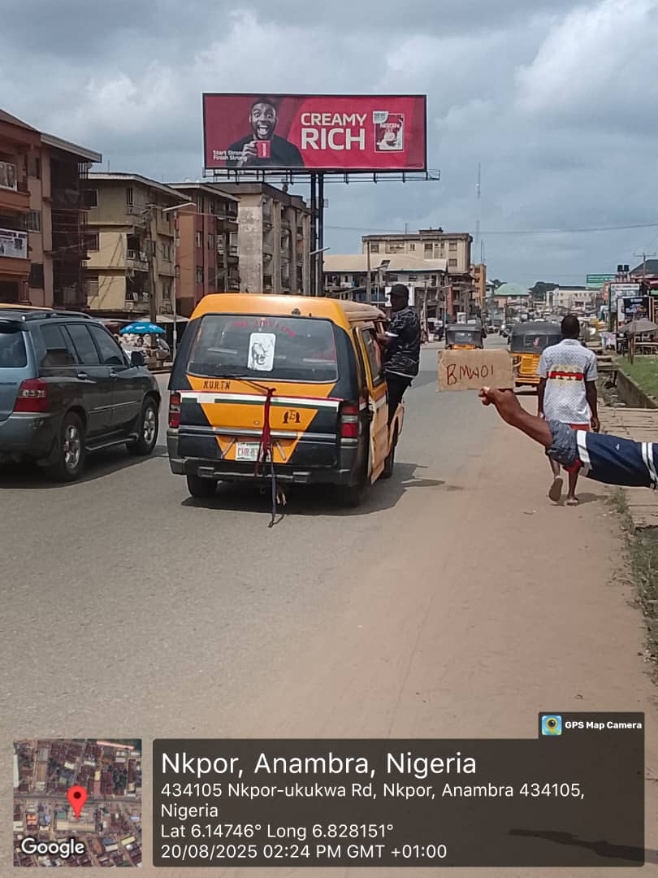
LOCATION: Onitsha, Nkpor Old Road, Opposite Cowbell, Anambra State.
STRUCTURE: Unipole
DIMENSION: 15m x 5m

Slide 31
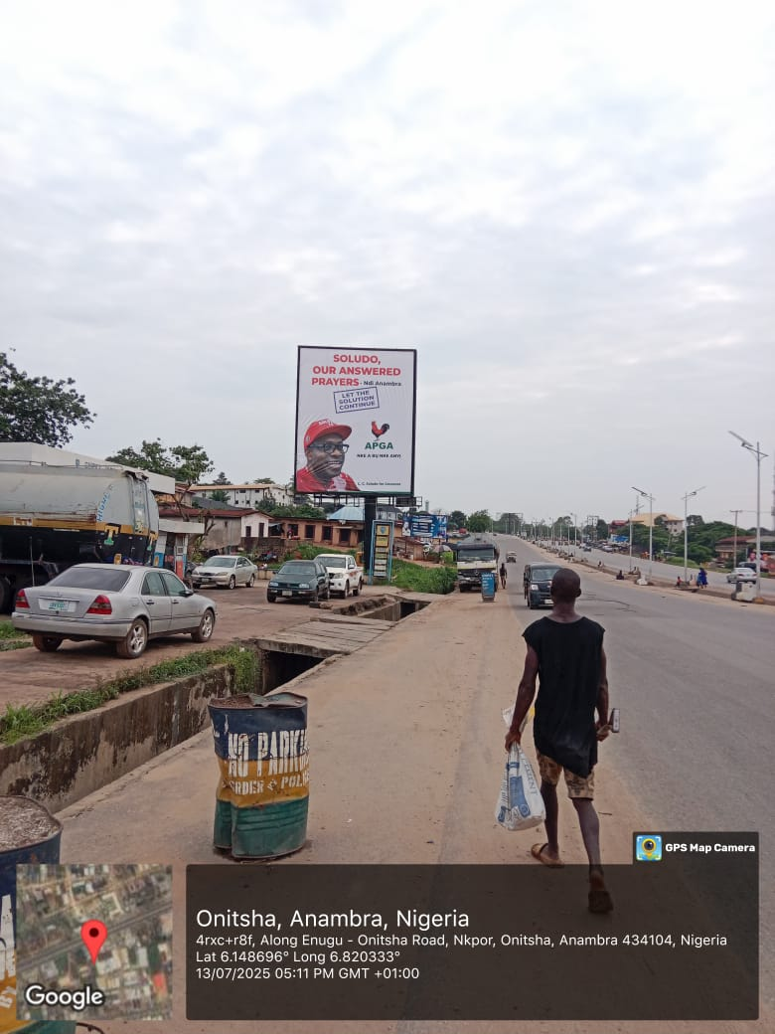
LOCATION: Onitsha, Along Onitsha-Enugu Expressway, by Chipet Filling Station, Anambra State.
STRUCTURE: Portrait
DIMENSION: 10m x 8m

Slide 32
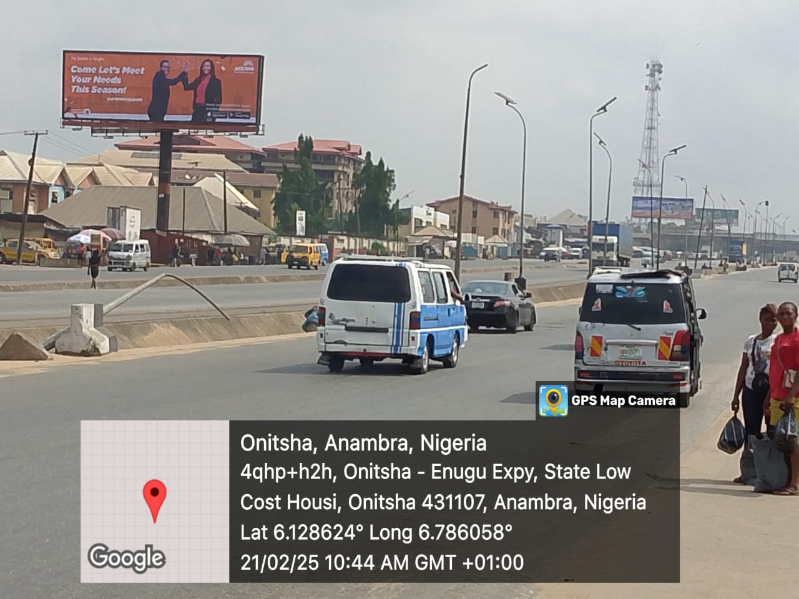
LOCATION: Onitsha, between Head Bridge and Upper-Iweka, by ABC Park, Onitsha, Anambra State.
STRUCTURE: Unipole
DIMENSION: 18m x 6m

Slide 33
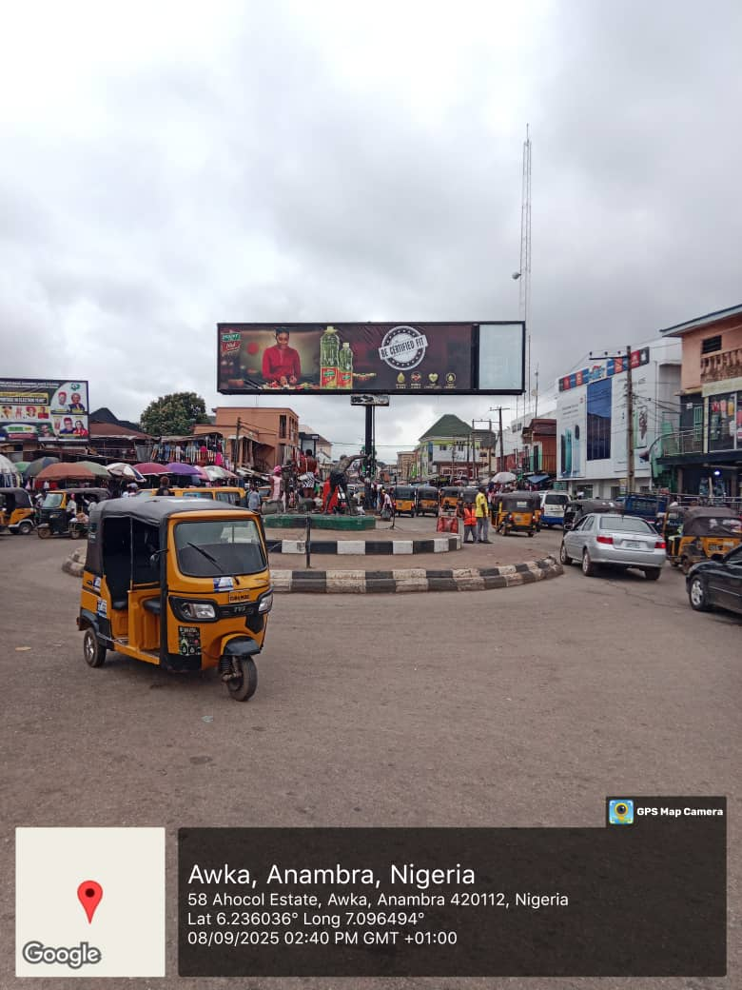
LOCATION: Along Eke Awka Market Roundabout, Near Streetlight, Awka, Anambra State.
STRUCTURE: Eyecatcher
DIMENSION: 13.4m x 3.5m

Slide 34
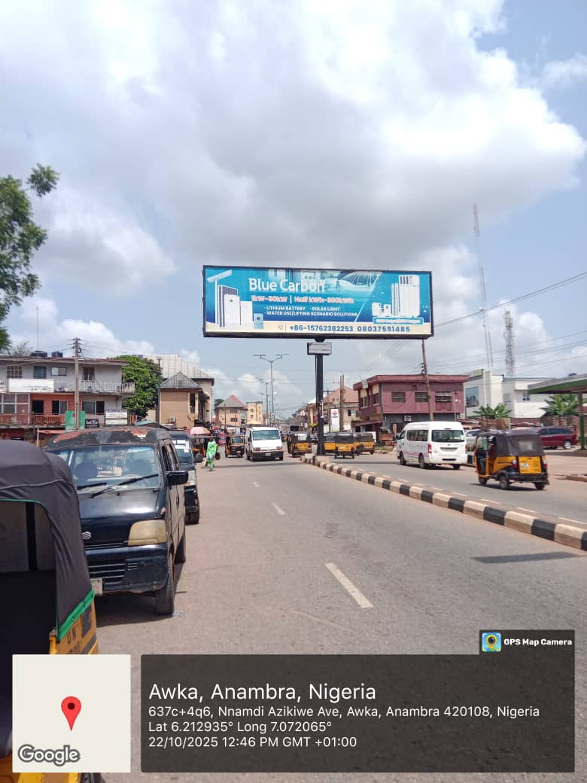
LOCATION: Along Zik Avenue, Eke-Awka Market, Awka, Anambra State.
STRUCTURE: Eyecatcher
DIMENSION: 12m x 3.5m

Slide 35
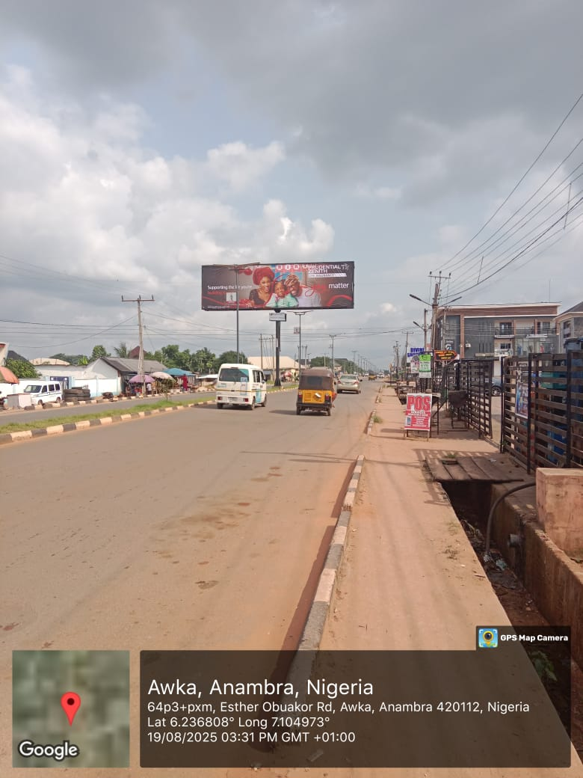
LOCATION: At Esther Obiakor Street, Agu-Awka, beside Divine Shopping Mall,
Awka, Anambra State.
STRUCTURE: Eyecatcher
DIMENSION: 12m x 3.5m

Slide 36
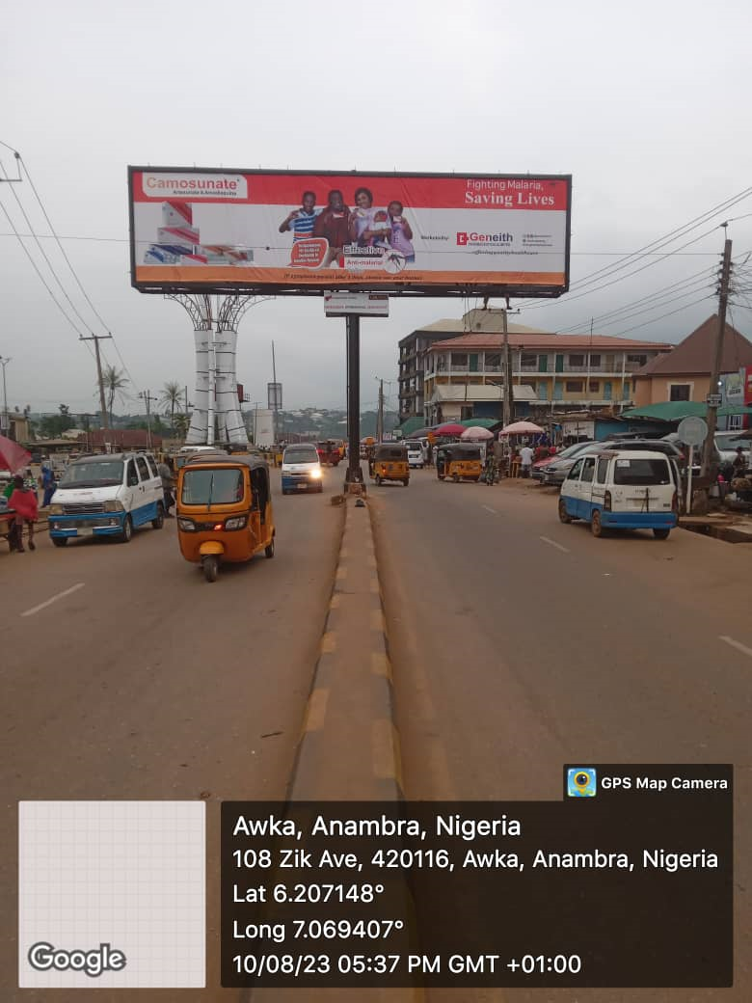
LOCATION: Amawbia Roundabout, beside State CID, Awka, Anambra State.
STRUCTURE: Eyecatcher
DIMENSION: 13.4m x 3.5m

Slide 37
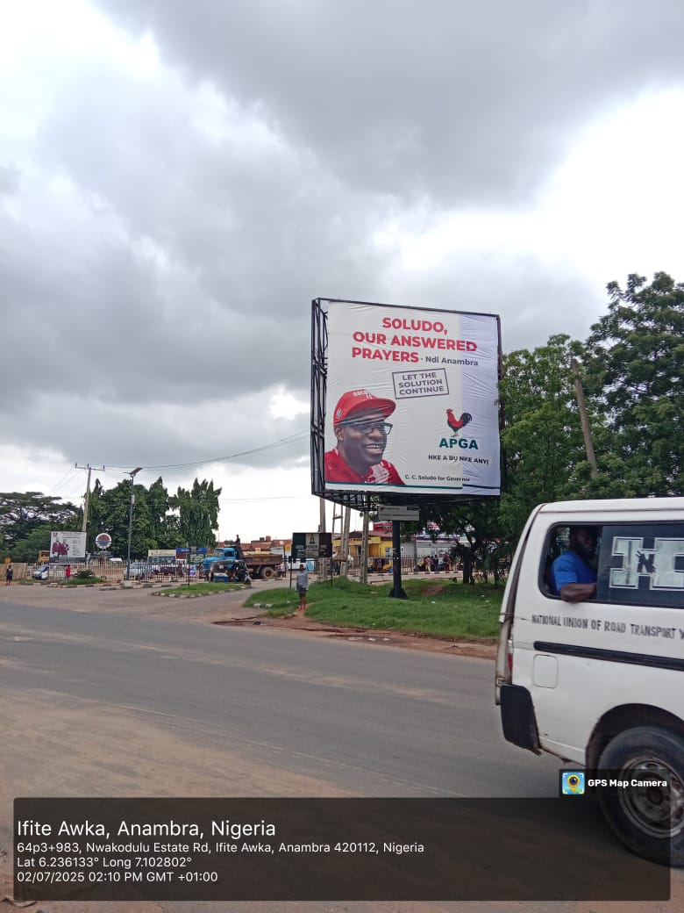
LOCATION: Agu-Awka, Book Foundation Junction after Government House, Onitsha-Enugu Expressway, Awka Anambra State.
STRUCTURE: Portrait (3 Faces)
DIMENSION: 8m x 8m

Slide 38
PORT HARCOURT

Slide 39
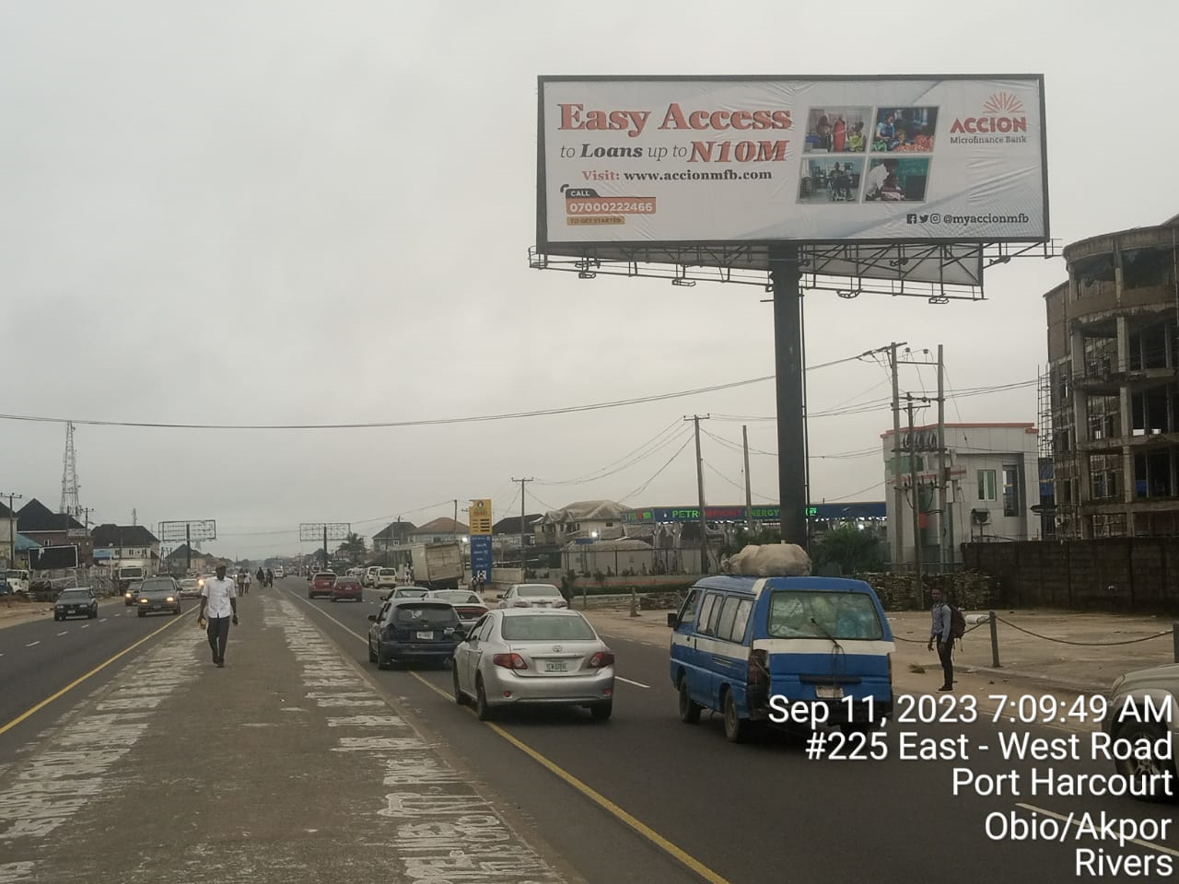
LOCATION: East-West Road by Rumuokoro Roundabout, Access (Diamond) and Zenith Bank, Port Harcourt, Rivers State.
STRUCTURE: Unipole
DIMENSION: 18m x 6m

Slide 40
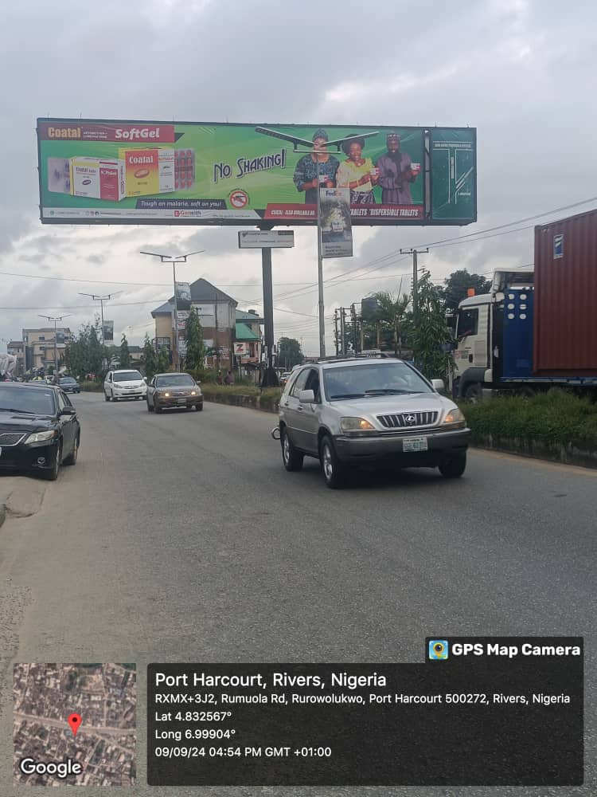
LOCATION: Along Rumuola Road, Port Harcourt, Rivers State.
STRUCTURE: Eyecatcher
DIMENSION: 14m x 3.5m

Slide 41
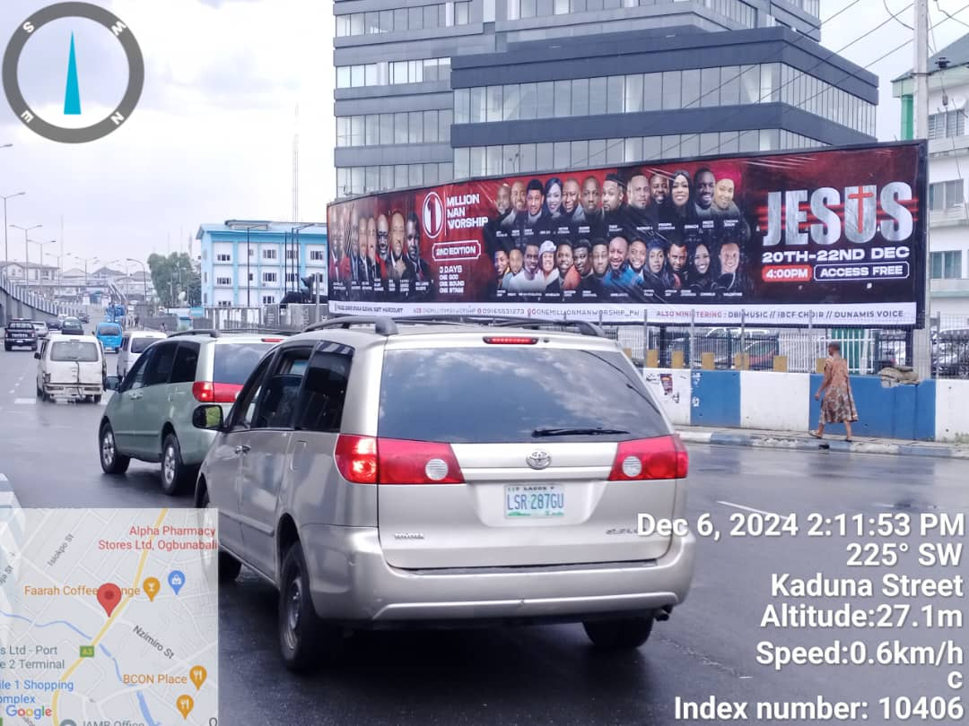
LOCATION: At CFC Bus Stop, Beside Federal Mortgage Bank, D-Line, Aba Road, FTT Park and Old GRA, Port Harcourt, Rivers State.
STRUCTURE: Stand Free Wall Drape (Landscape)
DIMENSION: 20m x 3m

Slide 42
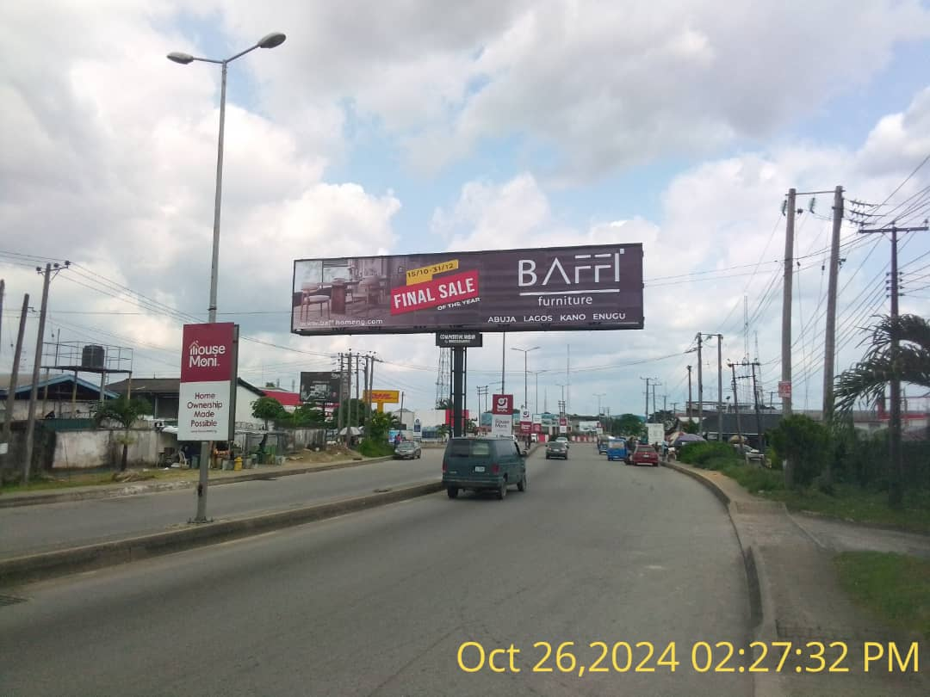
LOCATION: Along Trans-Amadi Road by Bewak, Port Harcourt, Rivers State.
STRUCTURE: Eyecatcher
DIMENSION: 16m x 3.5m

Slide 43
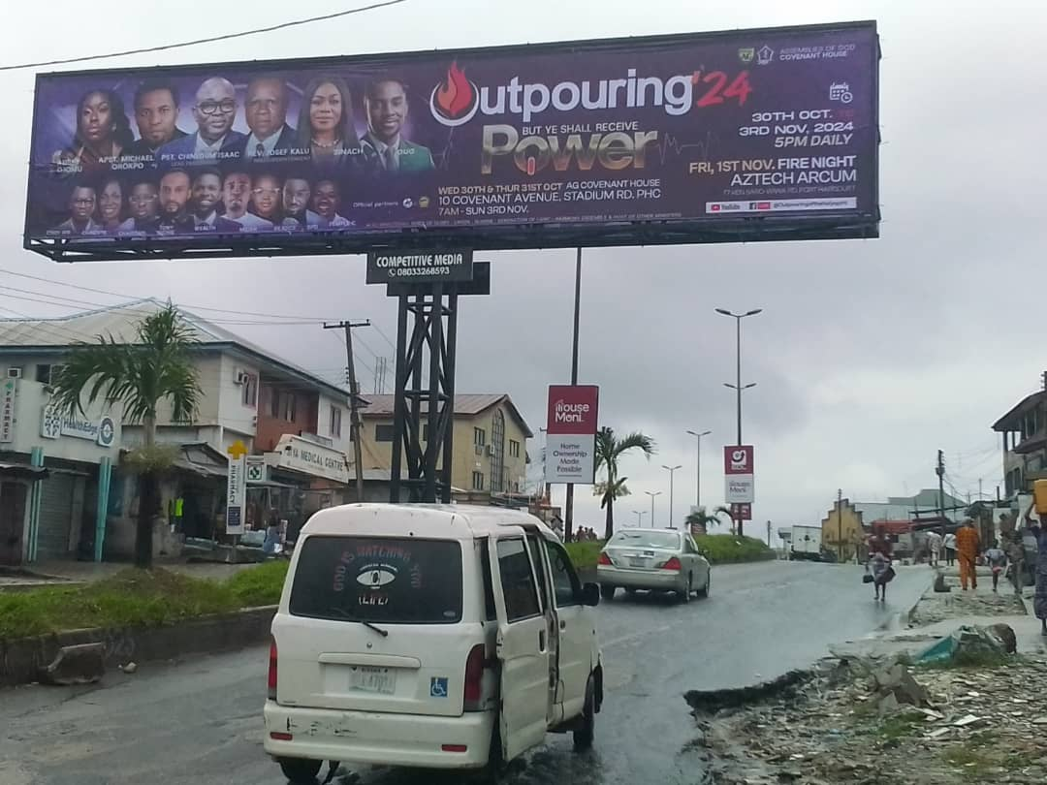
LOCATION: Along Old Aba Road, Rumuobiokani Junction, Port Harcourt, Rivers State.
STRUCTURE: Eyecatcher
DIMENSION: 16m x 3.5m

